Slide 1
Disaster Preparedness and Response Education System for Schools and Colleges``
Review-2
Roll Number | Student Name
20221CCS0115 | DHANYA D T
20221CCS0113 | C NIHARIKA
20221CCS0128 | BHAVANI
Under the Supervision of,
Dr. Ramesh Sengodan
Professor
School of Computer Science and Engineering
Presidency University
Name of the Program: B.TECH
Name of the HOD: Dr. Anandaraj S.P
Name of the Program Project Coordinator: Dr. Sharmasth Vali
Name of the School Project Coordinators: Dr. Sampath A K , Dr. Geetha A

Slide 2
Content
Abstract
Literature Review
Objectives
Architecture design
Modules
References

Slide 3
Problem Statement Number: SIH 25008
Category (Hardware / Software / Both) : Software
Problem Description:
Educational establishments, including schools and colleges, do not have a planned, continuous system of disaster preparedness and response training. Disaster awareness is confined to theoretical knowledge or irregular physical drills with no clear-cut mechanism or time for readiness assessment, or participation and response accuracy monitoring. This absence of systematic preparedness can create panic, confusion, and increased risk when disaster strikes. Therefore, the specific digital disaster preparedness and response education is required to
(a) provide knowledge to the participants
(b) conduct simulation-based disaster drills
(c) evaluate the preparedness levels of students and staff in educational institutes regarding disasters.

Slide 4
Objectives:
To educate students and staff about disaster preparedness.
To conduct virtual disaster response drills.
To evaluate preparedness using scoring and analytics.
To help schools and colleges improve disaster readiness.

Slide 5
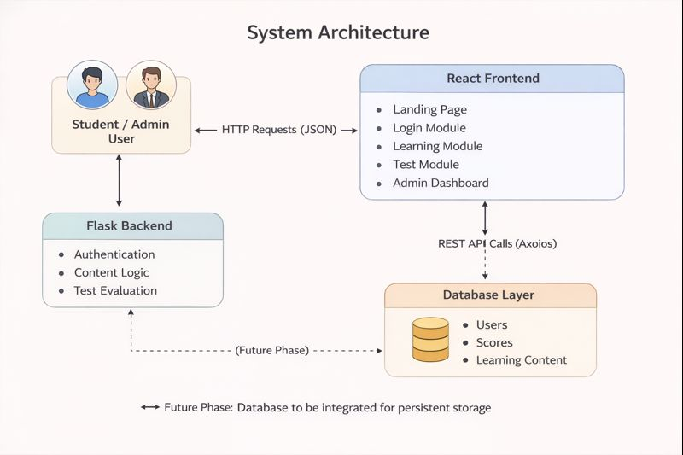
System Architecture
React frontend.
Flask backend.
API-based communication.

Slide 6
Modules
Student Module: Provides disaster awareness learning content and allows students to take preparedness tests for self-assessment.
Admin Module: Enables administrators to upload learning materials and monitor student participation and preparedness levels.
Evaluation Module: Assesses student responses, calculates preparedness scores, and provides feedback based on performance.

Slide 7
Literature Survey
Disaster education and community communication (2025)
https://www.frontiersin.org/journals/communication/articles/10.3389/fcomm.2025.1632436/full
Kaur & Singh (2024), Springer – E-Learning Systems for Disaster Preparedness
https://link.springer.com/article/10.1007/s44217-025-00771-5
Patel et al. (2022), Scopus Indexed Journal – Role-Based Disaster Management Systems
https://en.wikipedia.org/wiki/Sahana_Software_Foundation
Rahman et al. (2021), IEEE – Assessment-Based Disaster Training Models
https://pmc.ncbi.nlm.nih.gov/articles/PMC8838598/
World Bank (2020) , Technology for Disaster Resilience
https://www.worldbank.org/en/topic/disasterriskmanagement/overview

Slide 8
Github Link
GitHub Link:
https://github.com/dhanyadt/disaster-management

Slide 9


